Slide 1
CIS150 Periodic Update 1

Slide 2
Reminders
Thanks for your Survey responses (85%)
Reading and lecture material
Introduction, I.T. Benefits, Controversies
Strategic Uses of I.S.
Capital One Case Study
Case Studies in I.T. Ethics (Chapter 1) “Frameworks for Ethical and Policy Analysis”
Introduction to Critical Thinking Model

Slide 3
REACH
Free tutoring services available to all students
Get assistance with:
CIS100, CIS199, CIS300
Microsoft Excel, PowerPoint, Word, Access
Math and Programming skills
Flexible hours to accommodate student needs
Knowledgeable staff - top CIS300 students
A quiet place in Ekstrom Library (or MITC)

Slide 4
REACH
Can request individual or small group help:
http://reach.louisville.edu/tutoring/computer/
http://www.reach.louisville.edu/tutoring/general/request.html
Hours of operation:
Ekstrom Library (first floor - CRC) is open from 8am until 8pm Mon-Thu and 8am to 4pm on Friday
as well as from noon until 2pm on Sunday
iTech Zone (Miller I.T. Center) is also open from
8am until 8pm Mon-Thu and 8am to 4pm on Friday

Slide 5

Great Research Site
http://vlib.org/
The WWW Virtual Library (VL) is the oldest catalogue of the Web, started by Tim Berners-Lee, the creator of HTML and the Web itself, which came online in August of 1991.

Slide 6

And Something for Fun
http://www.gasbuddy.com/
Notes:
6

Slide 7

Favorite PC Utility
Download.com rated 5 out of 5!
FreeRAM XP Pro is a freeware application that frees and optimizes your computer's RAM (Random Access Memory), resulting in an increase in system performance and productivity. Automatically configures itself for ease of use and also features advanced options and customizability. It has been designed to be easy to use, yet highly customizable by computer novices and experts alike. (Note: This utility is not compatible with Vista.)
http://www.yourwaresolutions.com/software.html

Slide 8
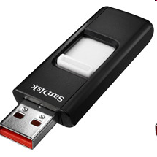

Top Technology Deal
http://www.abesofmaine.com/item.do?item=SDCZ8GBA11&id=SDCZ8GBA11
SanDisk 8GB Cruzer Micro
USB Flash Drive (New Design!)
only $16.29 + $1.49 shipping

Slide 9

Interesting I.T. Article
Get Smart About Skills Today

Slide 10
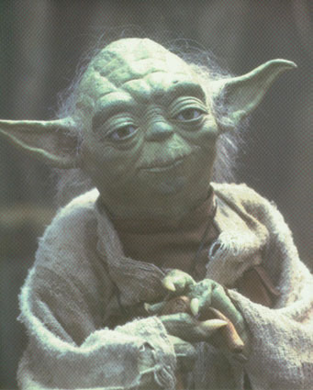
Un-Real World Quote
“Do or do not... there is no try.”
Jedi Master Yoda (in the future)
Fictional character in Star Wars

Slide 11
This Week in I.T.
Microsoft Office 2010 Beta draws 2 million, while MS stops sales of Word in order to comply with court ruling to remove XML
Consumer Electronics Show (CES 2010)
Dell announces it will introduce a prototype tablet PC as well as a new smartphone
Google Wave begins to catch on - several tools come together as for collaboration

Slide 12
Any Questions

